Slide 1
Lecture 9 Red-Black Trees
Department of Computer Science
Hofstra University
Notes:
Left-leaning Red–Black Trees
http://citeseerx.ist.psu.edu/viewdoc/summary?doi=10.1.1.139.282
B-tree
https://www.geeksforgeeks.org/b-tree-set-1-introduction-2/

Slide 2
Video Tutorials
Red-Black Trees // Michael Sambol
https://www.youtube.com/playlist?list=PL9xmBV_5YoZNqDI8qfOZgzbqahCUmUEin
Lecture slides based in this video series
Red Black Tree – Insertion
https://www.youtube.com/watch?v=9ubIKipLpRU
Another example

Slide 3
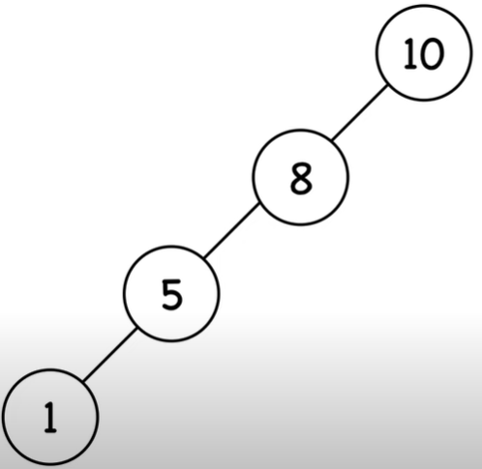
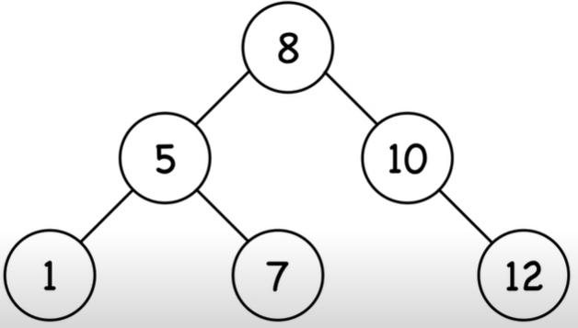
Binary Search Trees
Ordered, or sorted, binary trees.
Each node can have 2 subtrees.
Items to the left of a given node are smaller.
Items to the right of a given node are larger.
Balanced search trees have guaranteed height of O(log n) for n items
Red-Black Tree is a type of balanced search tree

Slide 4
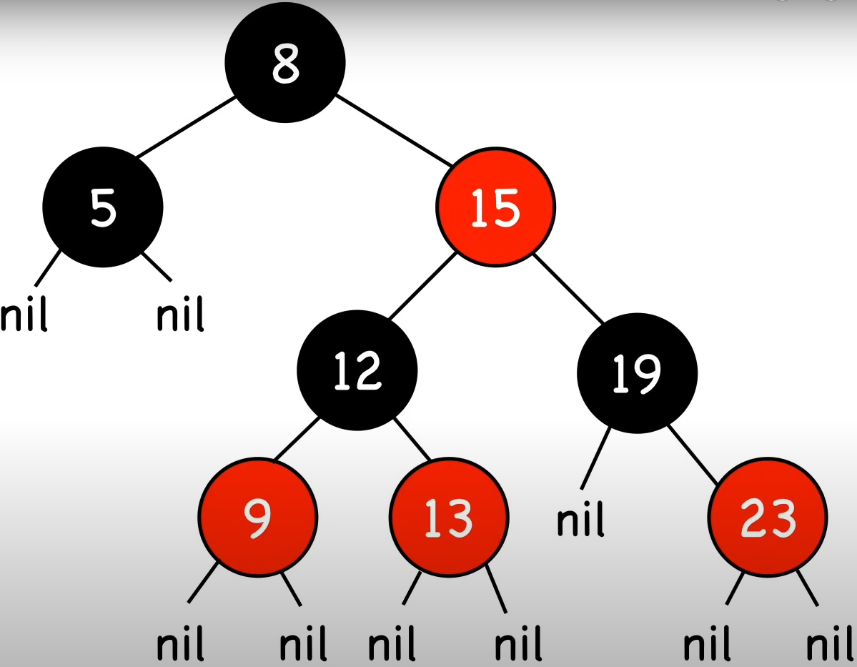
Red-Black Tree
1. A node is either red or black.
2. The root and leaves (NIL) are black.
3. If a node is red, then its children are black.
4. All paths from a node to its NIL descendants contain the same number of black nodes.
Path length excludes root node itself
Notes:
Nodes require one storage bit to keep track of color.

Slide 5
Additional Properties
Balanced search tree: the longest path (root to farthest NIL) is no more than twice the length of the shortest path (root to nearest NIL).
Shortest path: all black nodes (=2)
Longest path: alternating red and black (=4)
Operations: search, insert, remove, each with time complexity O(log(n)).
Insert and remove may result in violation of red-black tree properties, use rotations to fix it

Slide 6
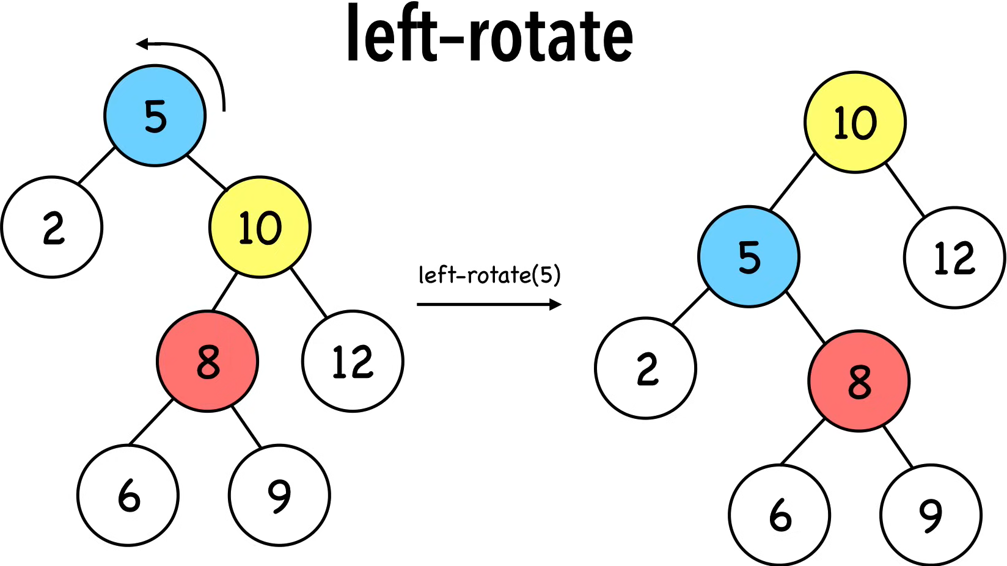
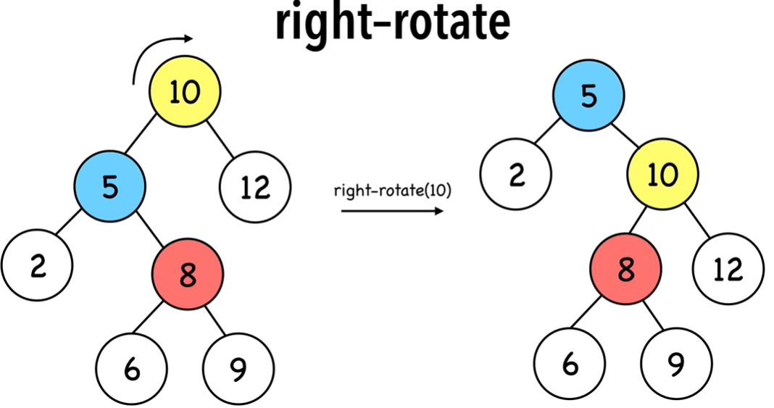
Rotations
Alters the structure of a tree by rearranging subtrees
Goal is to decrease the height of the tree to maximum height of O(log n)
Larger subtrees up, smaller subtrees down
Does not affect the order of elements
Time complexity O(1)
Notes:
left-rotate & right-rotate red-black

Slide 7
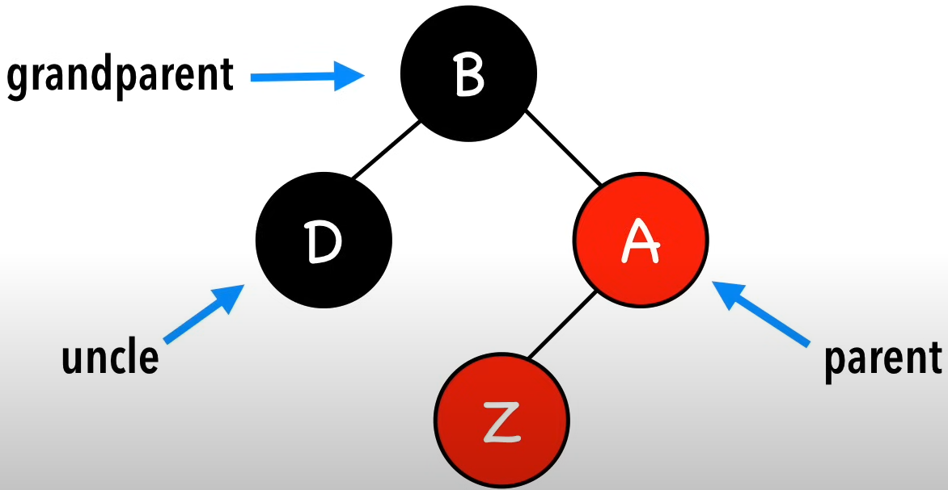
Insertions
Step 1. Insert Z and color it red
Step 2. Recolor and rotate nodes to fix violations
4 scenarios after inserting node Z
Case 0. Z = root
Color Z black
Case 1. Z.uncle = red
Recolor Z’s parents and grandparent
Case 2. Z.uncle = black (triangle)
Rotate Z.parent
Case 3. Z.uncle = black (line)
Rotate Z.grandparent & Recolor Z’s parents and grandparent

Slide 8


Case 0. Z = root
Color Z black
Color Z
black

Slide 9
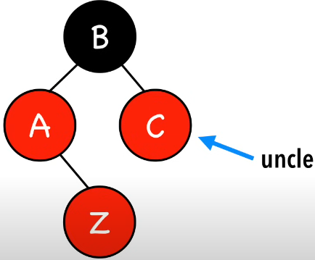
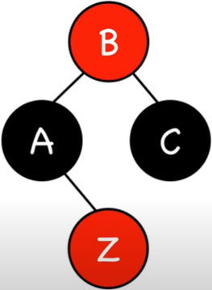
Case 1. Z.uncle = red
Recolor Z’s parents and grandparent
Recolor
Parents &
grandparents

Slide 10
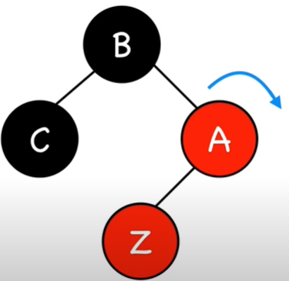
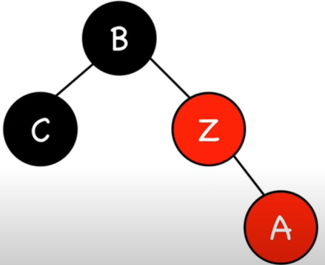
Case 2. Z.uncle = black (triangle)
Rotate Z.parent
rotate
Z.parent

Slide 11
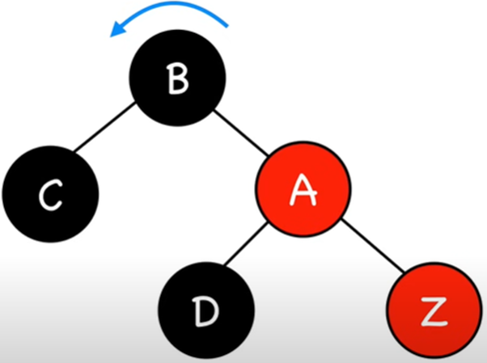
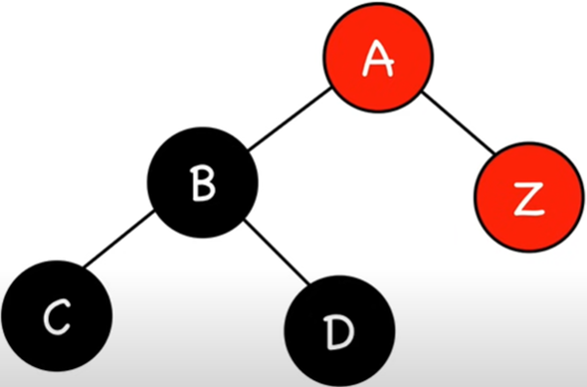
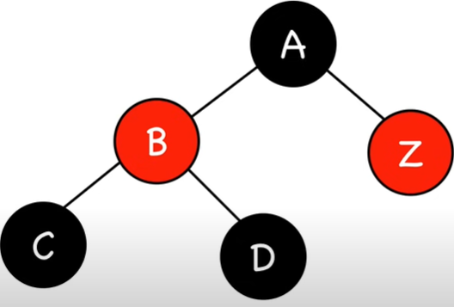
Case 3 Z.uncle = black (line)
Rotate Z.grandparent
rotate
Z.grandparent
recolor
Parents &
grandparents

Slide 12
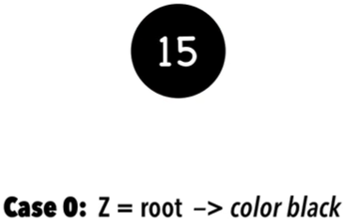
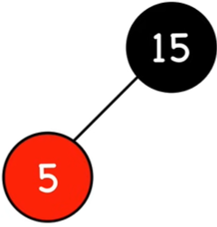
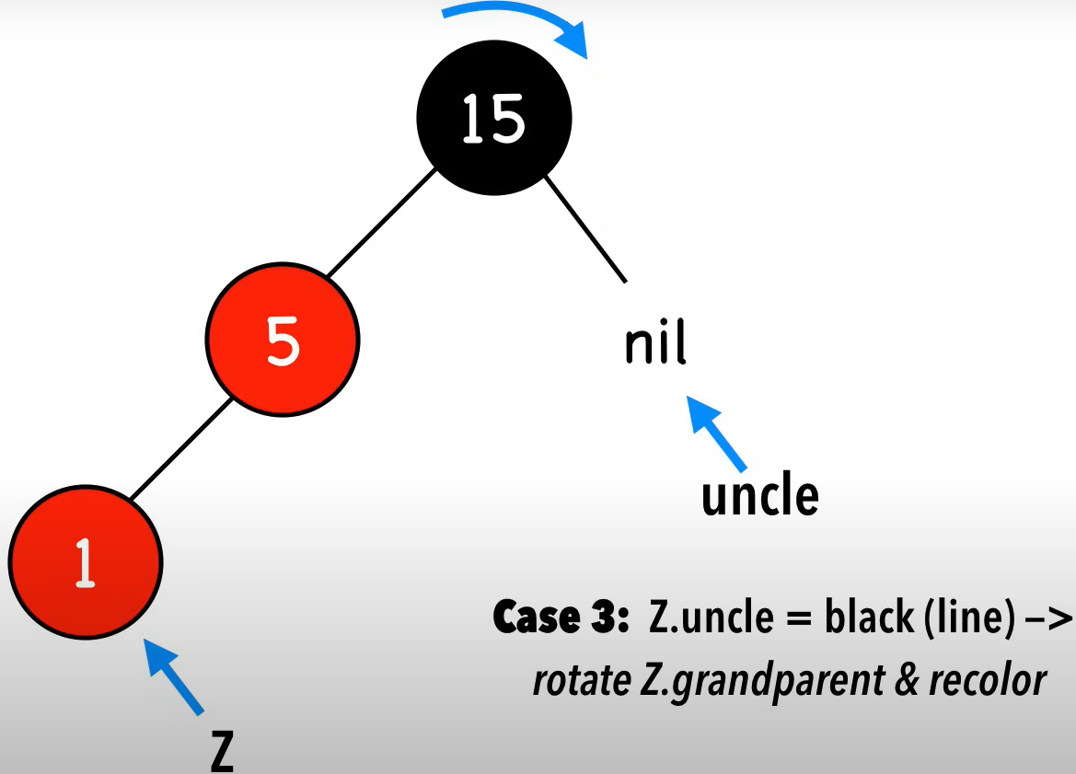
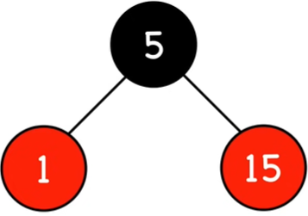
Example 1
insert 15
insert 5
insert 1

Slide 13
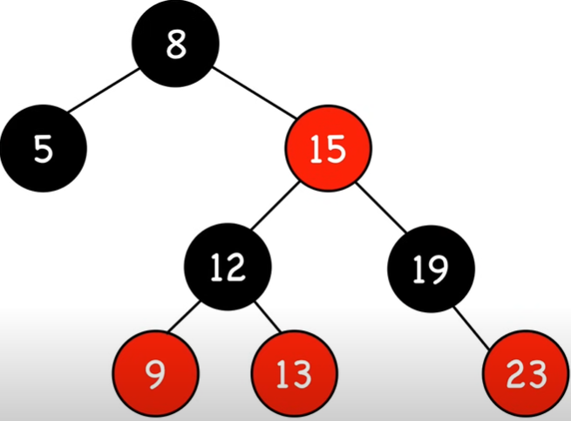
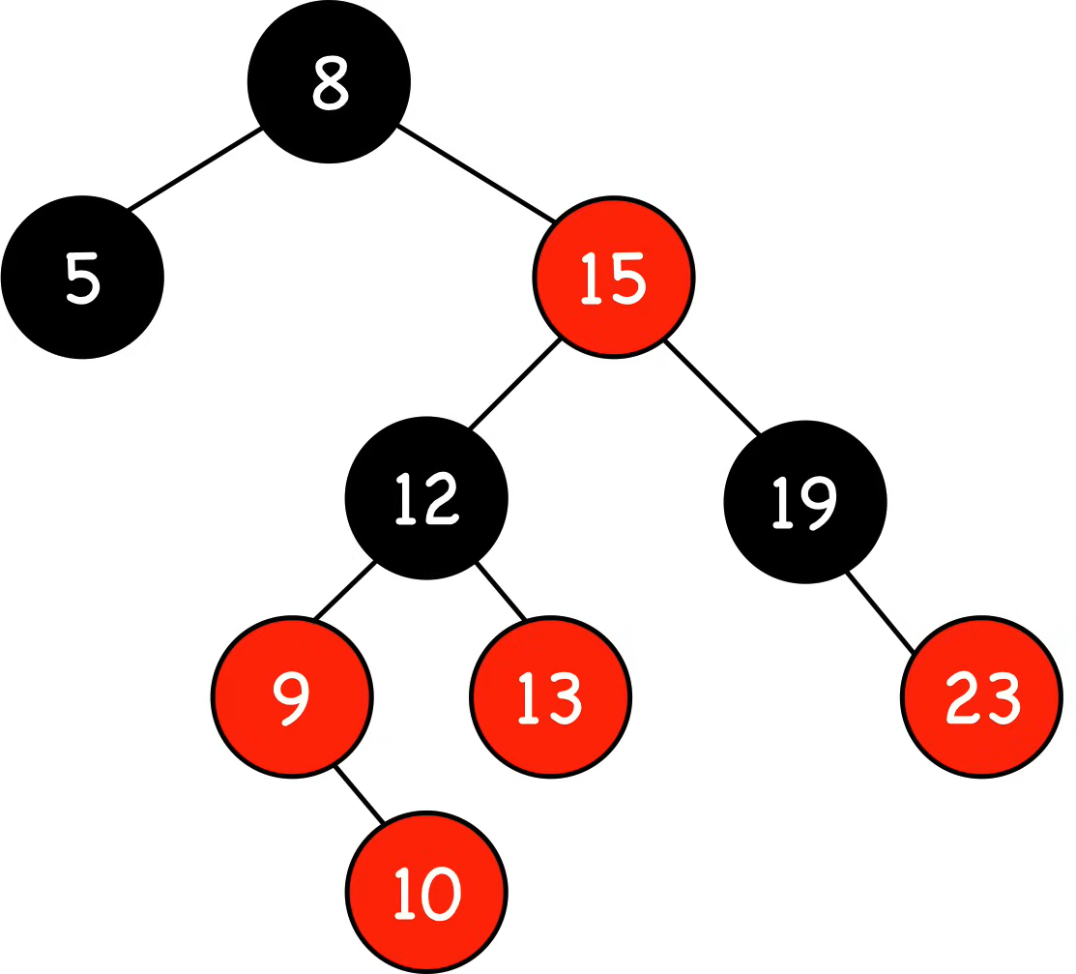
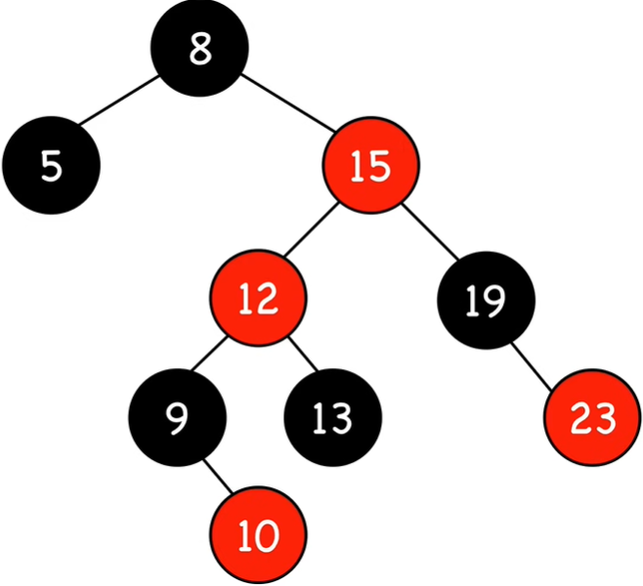
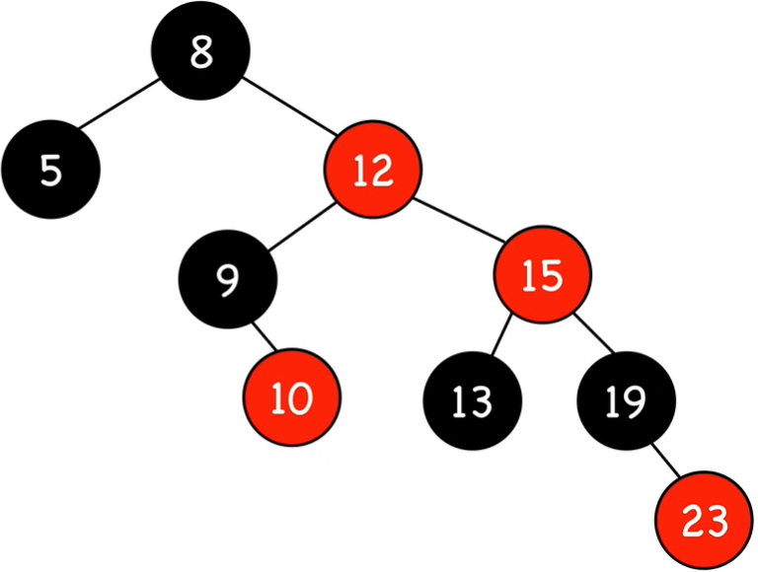
Example 2
insert 10
Z.uncle
Z
Case 2. Z.uncle = black
right rotate on 15
Z.uncle
Case 1. Z.uncle = red
recolor
Z.uncle
Z
Z

Slide 14
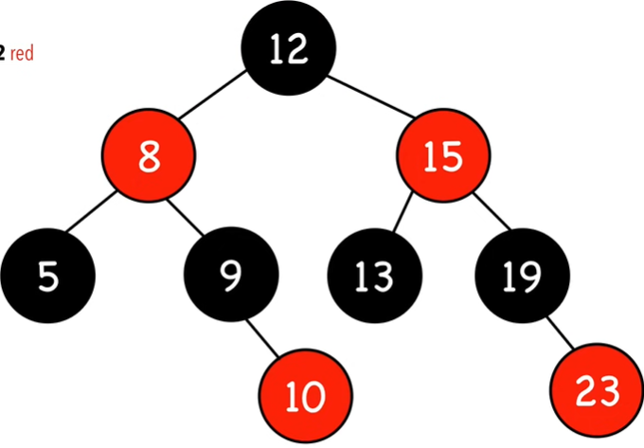
Example 2 Con’t
Case 2. Z.uncle = black
left rotate on 8 & recolor
Z.uncle
Z

Slide 15
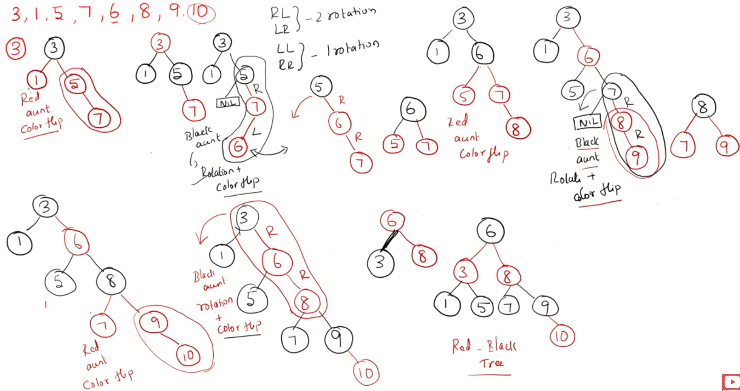
Another Example
Red Black Tree – Insertion
https://www.youtube.com/watch?v=9ubIKipLpRU

Slide 16
Time Complexity
1. Insert : O(log(n))
maximum height of red-black trees
2. Color red : O(1)
3. Fix violations :
Constant # of:
a. Recolor : O(1)
b. Rotation: O(1)
Overall time complexity: O(log(n))

Slide 17
Applications
Red–black trees are widely used as system symbol tables.
Java: java.util.TreeMap, java.util.TreeSet.
C++ STL: map, multimap, multiset.
Linux kernel: completely fair scheduler, linux/rbtree.h.
Emacs: conservative stack scanning.

